Slide 1



Achieving Potential:
Stereotypes, Barriers & Success
Specialist Autism Awareness Trainer
Autism East Midlands

Slide 2
The law, Congress states:
Disability is a natural part of the human experience and in no way diminishes the right of individuals to participate in or contribute to society. Improving educational results for children with disabilities is an essential element of our national policy of ensuring equality of opportunity, full participation, independent living, and economic self-sufficiency for individuals with disabilities.

Slide 3

Quiz : True or False?
All people with Autism have a learning disability
All People with Autism have challenging behaviour
Autism is known as a hidden disability
Autism falls under the Equality Act 2010
1 in 100 people have Autism
Autism is a wish to avoid social contact
Autism is a lifelong condition
There is no cure for Autism
All people with Autism have special gifts or talents
Autism is a condition which varies in severity
Autism is a condition where people cant cope with change

Slide 4
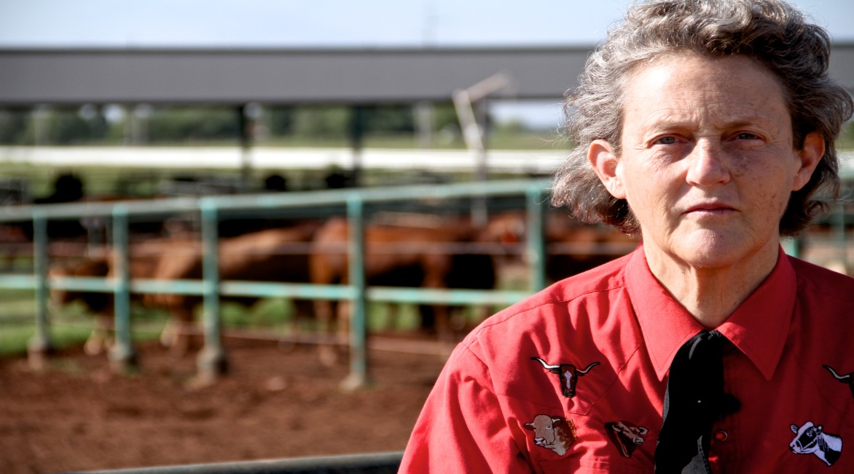

“The word “autism” still conveys a fixed and dreadful meaning to most people – they visualize a child mute, rocking, screaming, inaccessible, cut off from human contact. And we almost always speak of autistic children, never of autistic adults, as if such children never grew up, or were somehow mysteriously spirited off the planet, out of society”
Temple Grandin PhD

Slide 5
Autism Spectrum Disorder
Autism is a lifelong neurological condition which affects the way that a person communicates and how they experience the world around them
No two individuals with autism are alike – they may share common differences but their autism affects them in unique ways.
Ranges from severe (low functioning autism) to High functioning autism/Asperger Syndrome
Roughly 1 in a 100 people in the UK have autism, around 700,000 people.
Notes:
Very brief summary of the difference between what we have now and what MAY be coming.
Important distinction is that commissioners will need to be able to see the impact of a specialist service via identified and improved outcomes, not just an assertion that services are better because they are provided by specialist staff. Progression will be important as it will be seen as a way of reducing cost as well as increasing independence. We need to support our teams to understand that increasing independence is a key and valid reason to move towards an outcome focus, and in many cases this is already what you are doing – we are just not good at evidencing this reliably, consistently or ( worst case scenario ) at all.

Slide 6
Autism is not a learning disability or a mental illness
Autism is not something to be cured
Largely thought to have a genetic link
Women and girls have autism too!
Autism can co-exist with other conditions
Only 15% of people with autism are employed
Notes:
Very brief summary of the difference between what we have now and what MAY be coming.
Important distinction is that commissioners will need to be able to see the impact of a specialist service via identified and improved outcomes, not just an assertion that services are better because they are provided by specialist staff. Progression will be important as it will be seen as a way of reducing cost as well as increasing independence. We need to support our teams to understand that increasing independence is a key and valid reason to move towards an outcome focus, and in many cases this is already what you are doing – we are just not good at evidencing this reliably, consistently or ( worst case scenario ) at all.

Slide 7
What do autistic people want?
Choice and control
Meaningful activity and employment
Good health and emotional well-being
Inclusion in local communities
Acceptance and understanding
The right support at the right time

Slide 8
THE PERCEPTION OF AUTISM
WOMEN & GIRLS ON THE SPECTRUM
HEALTHCARE
EMPLOYMENT
Speech and Language
DIAGNOSIS
EDUCATION
MENTAL HEALTH
Barriers

Slide 9
late
many adults receive diagnosis late in life
misdiagnosis
may have had previous mental health diagnoses
Lack of specialist services
post code lottery
diagnosis is key to people accessing the right support
NOT HAVING A DIAGNOSIS
Notes:
Each of the foundation stones will break down into a range of component parts that are necessary for us to be able to provide high quality, person centred, autism specific services to the individuals with whom we work.
For example …..

Slide 10
Gender stereotype
misdiagnosis
Late diagnosis
Increased mental health problems
Coping strategies mask autism
lack of knowledge as to how autism presents in women
“Going under the radar”
Lack of quality mental health support
Chronic anxiety, lack of confidence
“You can’t be autistic you’re a girl”
BARRIERS FOR WOMEN & GIRLS ON THE SPECTRUM
Notes:
Under diagnosis
Lack of specialist knowledge

Slide 11
NHS Mental health Services
lacking in some areas
front line staff need specialist training in autism
Diagnosis matters
early diagnosis important
61% of people who got a diagnosis said it was a relief
Mental illness
50% suffer from anxiety or depression
Autistica report (2016) Autistic adults without LD are 9 times more likely to die from suicide
MENTAL HEALTH AS A BARRIER
Notes:
Each of the foundation stones will break down into a range of component parts that are necessary for us to be able to provide high quality, person centred, autism specific services to the individuals with whom we work.
For example …..

Slide 12

What needs to change?
Better autism awareness within communities
More specialists involved in diagnosis
Raise the profile of women and girls

Slide 13
What needs to change?
Better mental health support
Advocacy
Coaching and mentoring
Employment support

Slide 14
Issues in the workplace
All of these things can affect someone being able to obtain or maintain employment :
Sensory issues e.g. the environment
Communication issues – interacting with others
Literal use of language, insensitive to feelings
Misunderstandings
Can seem odd eccentric
Subject of bullying
Social issues – socialising

Slide 15

OTTFFS…….?
What is the next letter in the sequence?

Slide 16
Success in Employment
Reasonable adjustments:
Raise awareness of Autism amongst staff
Accommodate sensory needs
It is helpful for feedback to be written down – in a visual format

Slide 17
Success in Employment
Reasonable adjustments:
Try to express expectations as literally as possible
Own desk rather than “hot desking”
Tap into special interests – some of us are excellent researchers and advocates

Slide 18
Success in Employment
Support strategies:
Support to self monitor anxiety levels in order to ensure emotional wellbeing
Be aware of learning styles. Individuals may not be able to multitask or think abstractly!
Practical demonstrations are useful
Coaching and mentoring
Acceptance and understanding key to wellbeing

Slide 19

Coaching and Mentoring
“I have found it particularly useful to have a mentor/advocate who has AS themselves and is also a teacher working in FE/HE as this has enabled me to have a greater understanding of myself, not to feel so alone and has helped my parents to understand me better”
Source: Leeds Autism Aim Project

Slide 20
